Slide 1


PCOD & PCOS
Awareness for every woman
Know your body. Trust your symptoms. Take charge of your health.
Gunvanti Foundation

Slide 2
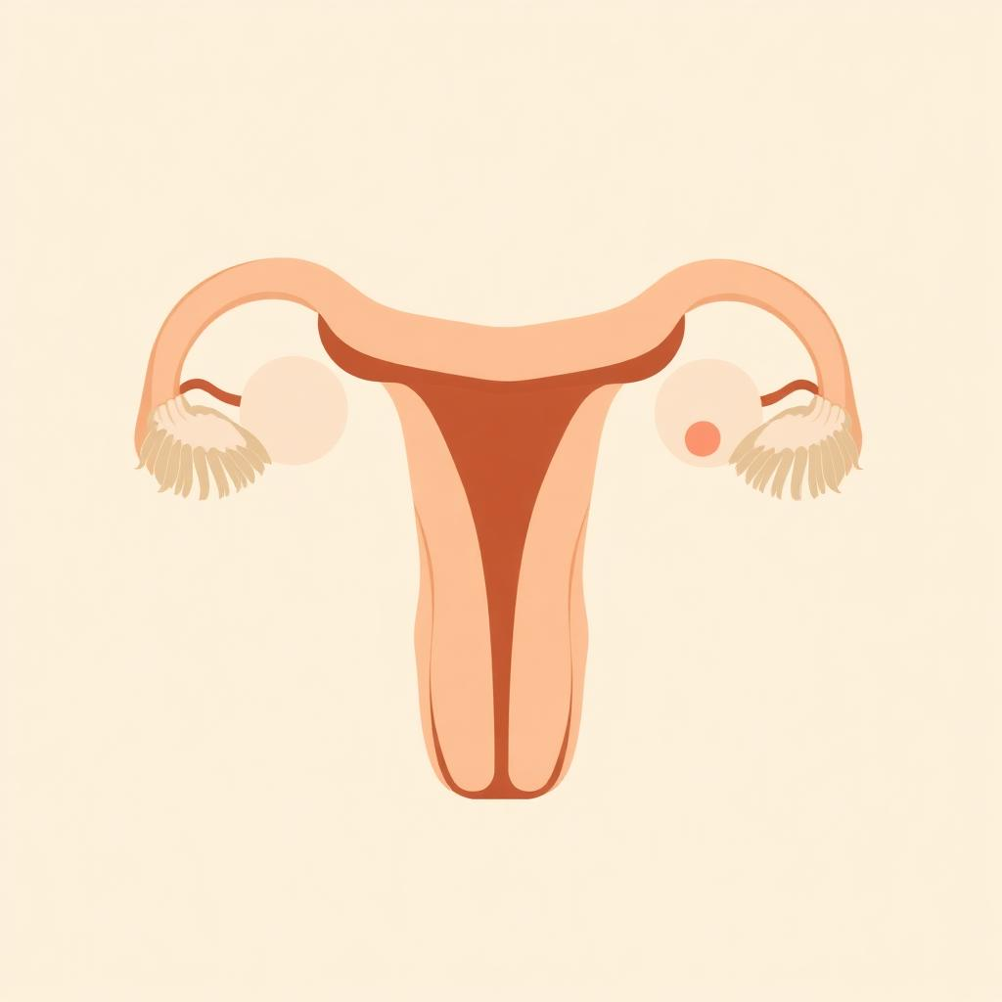
WHAT IS PCOD
Polycystic Ovarian Disease
PCOD is a condition in which the ovaries release immature or partially mature eggs that, over time, can turn into cysts. This affects ovulation and hormone balance.
• Very common — affects about 1 in 5 Indian women
• Often linked to lifestyle, diet, weight and stress
• Manageable with balanced food, movement and care
• Symptoms can improve with consistent healthy habits
Gunvanti Foundation • Women's Health Awareness

Slide 3
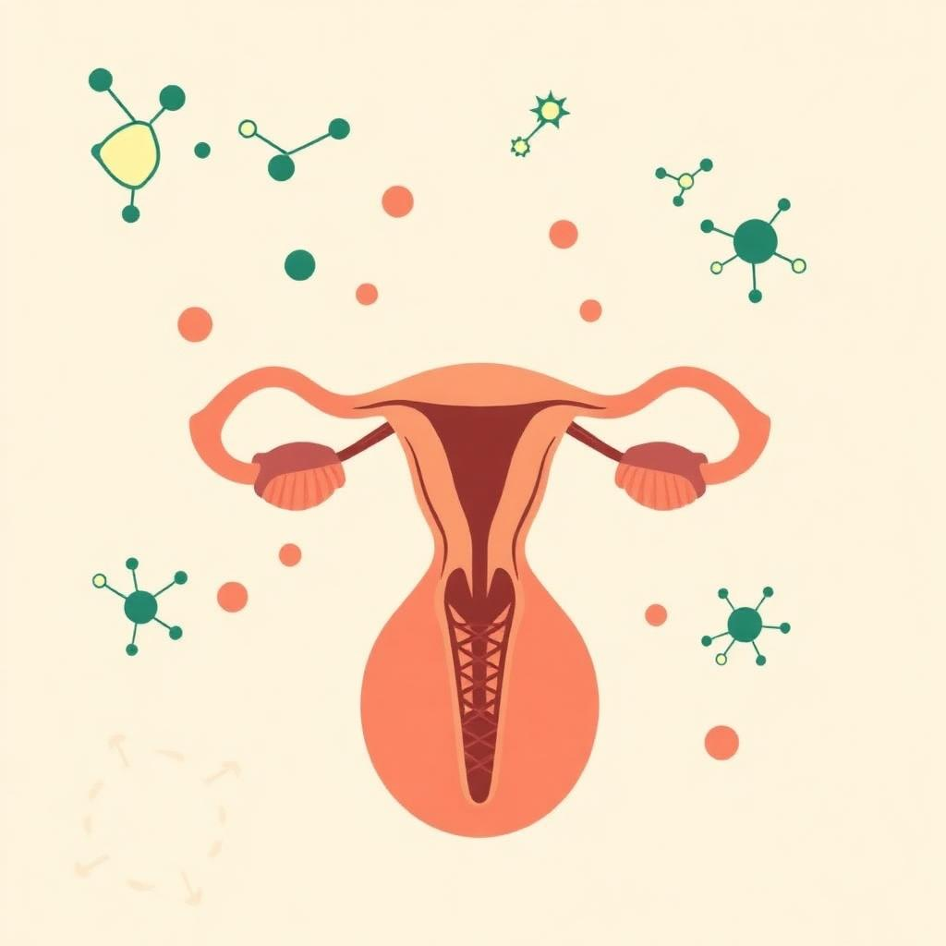
WHAT IS PCOS
Polycystic Ovary Syndrome
PCOS is a hormonal and metabolic disorder where the body produces higher than normal levels of male hormones (androgens). It impacts periods, fertility and overall health.
• A syndrome — a group of connected symptoms
• Affects roughly 1 in 10 women worldwide
• Linked to insulin resistance and inflammation
• Needs long-term lifestyle care and medical guidance
Gunvanti Foundation • Women's Health Awareness

Slide 4
PCOD VS PCOS
How they differ
Aspect | PCOD | PCOS
Nature | Condition of the ovaries | Hormonal & metabolic syndrome
Cause | Lifestyle, diet, hormones | Insulin resistance, genetics, hormones
Severity | Generally milder | More serious, long-term impact
Fertility | Usually not a major issue | Common cause of infertility
Treatment | Diet, exercise, lifestyle | Lifestyle + medical management
Gunvanti Foundation • Women's Health Awareness

Slide 5
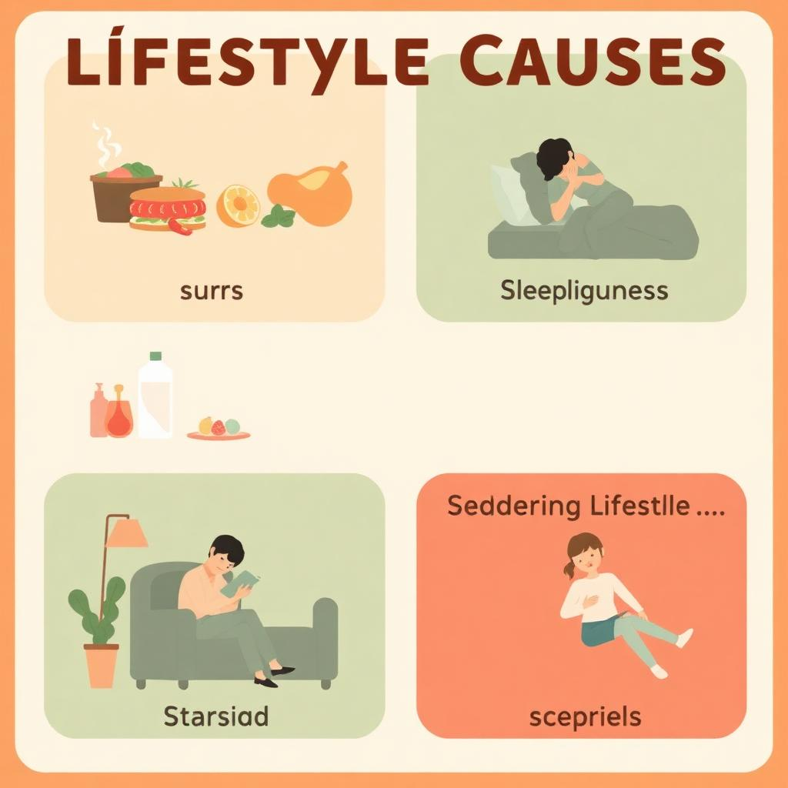
WHY IT HAPPENS
Common causes
Genetics Family history of PCOD/PCOS increases risk.
Hormonal imbalance Excess androgens disrupt ovulation cycles.
Lifestyle Junk food, stress and poor sleep are key triggers.
Weight & insulin Insulin resistance and weight gain feed the cycle.
Chemical exposure Pads with chemicals & plastics may worsen symptoms.
Gunvanti Foundation • Women's Health Awareness

Slide 6
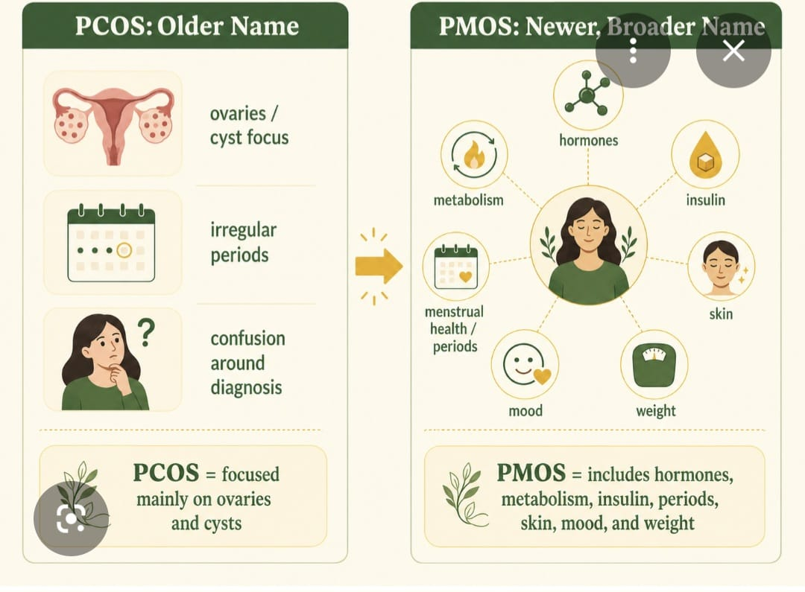
KNOW THE SYMPTOMS
Listen to your body
Irregular or missed periods
Excess hair on face / body
Heavy or painful bleeding
Hair thinning on scalp
Unexplained weight gain
Mood swings, anxiety, fatigue
Acne & oily skin
Difficulty getting pregnant
Gunvanti Foundation • Women's Health Awareness

Slide 7

70%
of women with PCOS remain undiagnosed
Awareness is the first step. Talk to a doctor, track your cycle, and don't ignore your symptoms.
Gunvanti Foundation • Women's Health Awareness

Slide 8

HEALTHY HABITS
Small steps, big change
Balanced meals Whole grains, greens, protein. Less sugar & maida.
Move daily 30 minutes of walking, yoga or strength training.
Sleep well 7–8 hours of quality rest — non-negotiable.
Manage stress Breathing, journaling, time with loved ones.
Hydrate 2–3 litres of water through the day.
Track your cycle Notice changes early. Knowledge is power.
Gunvanti Foundation • Women's Health Awareness

Slide 9

MYTHS VS FACTS
Let's set the record straight
MYTH PCOD/PCOS only affects overweight women.
FACT Slim women can have it too — it is hormonal.
MYTH You cannot get pregnant with PCOS.
FACT With right care, many women conceive naturally.
MYTH It will go away on its own.
FACT It needs lifestyle change and sometimes medicine.
MYTH Skipping periods is no big deal.
FACT It is a sign — please get yourself checked.
Gunvanti Foundation • Women's Health Awareness

Slide 10

You are not alone.
Together, we break the silence around PCOD & PCOS.
Share this awareness with a sister, a friend, a daughter.
Early knowledge changes lives.
— Gunvanti Foundation

